Slide 1

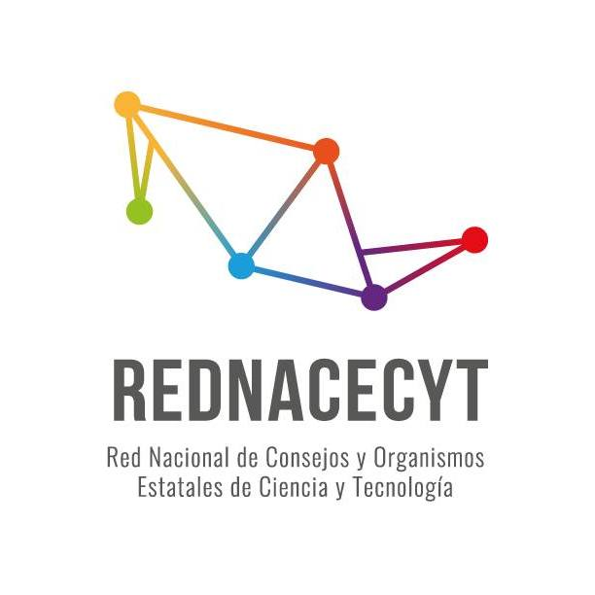
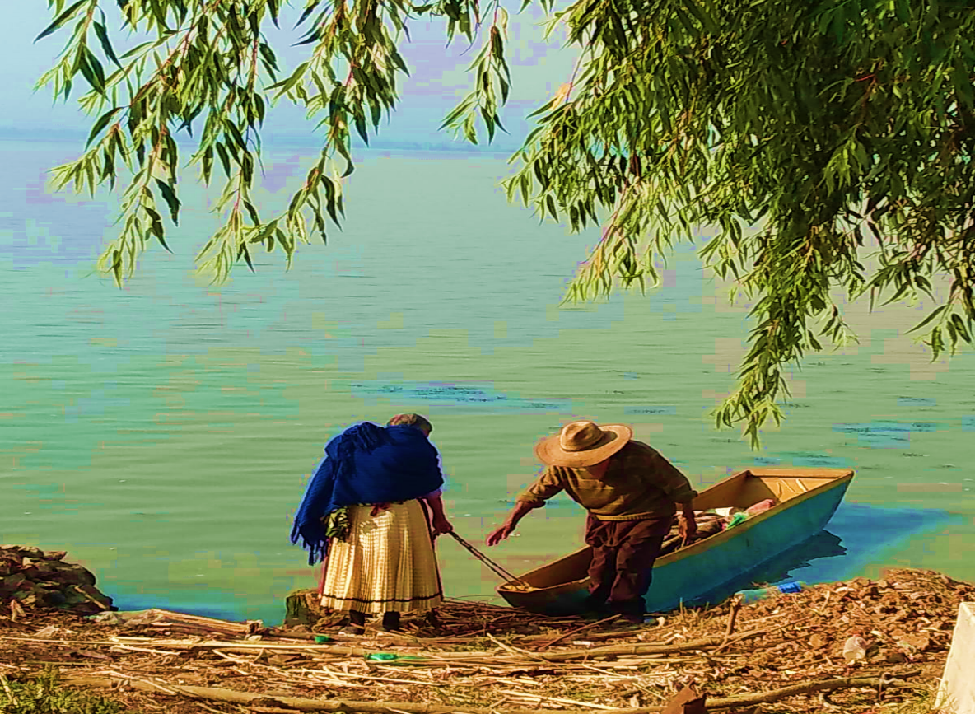
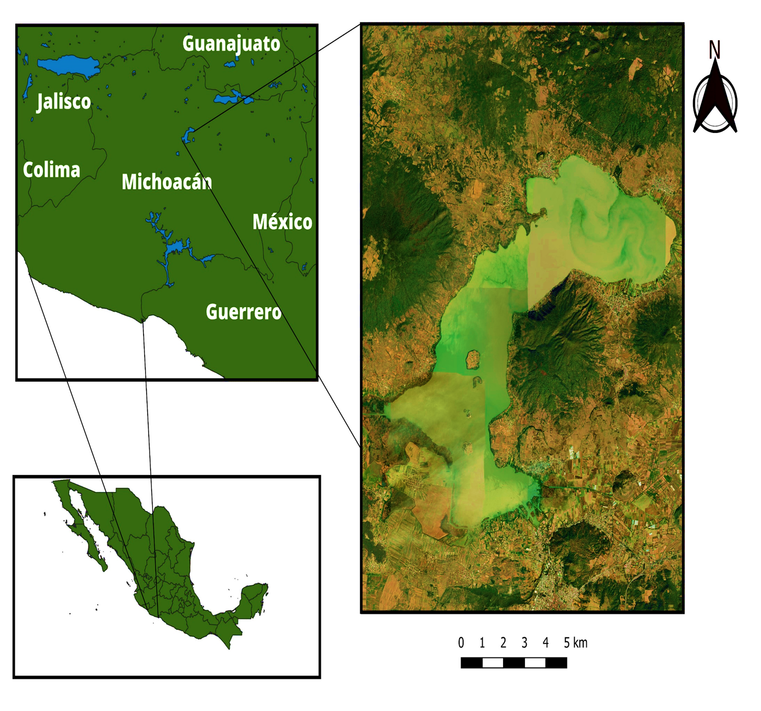



Indigenous Perception of Environmental Restoration Programs in the Pátzcuaro Lake Basin
Authors: María Guadalupe García Alonso; Agnes Medinaceli
Contact: mar.garcia.al26@gmail.com
Introduction
The Lake Pátzcuaro basin is located in the state of Michoacán, México. It has cultural, gastronomic, and historical importance for the Purépecha indigenous people, who have inhabited the region for centuries as well as for the broader population. However, it is now threatened by climate change and the over-extraction of natural resources. In response, the four levels of governments have implemented different top-down restoration programs excluding the traditional knowledge of the indigenous population which is closely tied to their worldview and practices. As the indigenous communities are the most directly connected to the basin’s natural resources, and their livelihoods depend largely on these ecosystems it is paramount to consider their perspectives. Therefore, the objective of this research is to analyze the indigenous population’s perception of environmental programs in the Lake Pátzcuaro basin in the period from 1997 to 2023, as a component to be considered in current and near-future environmental programs.
Methodology
This research employed a mixed method, combining qualitative and quantitative methods, with a bottom-up approach. To capture the perceptions of indegenous communitites, 48 semistructured interviews were conducted with indigenous inhabitants from four communities (Isla Uranden de Morelos, Santa Fe de la Laguna, Jarpacuaro and Tarerio).
Below is a list of the environmental programs considered in this research.
Table 1: Environmental restoration programs applied in the region
NAME OF THE ENVIRONMENTAL PROGRAM | INSTANCE THAT APPLIED IT
Aquatic weed clearing | Estate, Community and Private enterprise
Reforestation plan | Federal and Community
Pátzcuaro 2000 plan | Federal e research Institution
Wastewater and solid waste treatment | Community
Rainwater collection and storage system for homes and rural communities | ONG
Environmental education workshops | ONG
Plan to repopulate species in the lake | Federal
Relevant literature
The Lake Pátzcuaro basin has been the subject of extensive research since 1936. Key contributions include studies by CESE (1986), Reyes Ruiz (2005), Toledo et al. (1992), and Ortiz-Paniagua (2004), which offer valuable insights into the region’s environmental conditions, ecological development, and conservation efforts. These works focus on evaluating programs implemented, through institutional and academic participation, while also analyzing the economic investments made for each environmental project. Although these studies have significantly enhanced our understanding of the economic and environmental dimensions of the interventions in the Lake Pátzcuaro basin, they overlook critical social factors, particularly indigenous perspectives on environmental issues.
Results
The results obtained in this research were the following:
It is necessary to involve women and men from indigenous communities, particularly those with a Purépecha worldview, in the creation, design, execution, monitoring, and evaluation of environmental programs through dedicated committees.
There is a lack of effective dissemination, analysis, and debate surrounding the environmental programs and activities promoted by the four levels of government.
Environmental programs implemented by ONGs are better known among the surveyed population, this is due to their integration of citizen participation.
There is a insufficient inter-institutional coordination among the various stakeholders involved in addressing environmental problems, hindering the development of collaborative and alternative solutions.
Some Purépecha communities need to reclaim and strengthen their connection with the land and revalue natural resources.
The migration of young people to cities and to the United States has led to a disconnection from the ancestral knowledge that elders in the community hold regarding environment stewardship.
Figure 2. Ancestral practices for the care of the lake
Contextualization of the problem
The Lake Pátzcuaro basin faces significant threats from climate change, accelerated environmental deterioration, and the over-extraction of natural resources. These challenges have prompted responses from various levels of government, academic institutions, civil organizations, and civil society, resulting in numerous environmental restoration programs. However, most of these initiatives follow a top-down approach that fails to meaningfully engage local communities, particularly indigenous groups. As a result, the potential long-term positive impacts of these efforts may have been limited.
Location of Area study
Lake Pátzcuaro is a picturesque and culturally significant freshwater lake located in the state of Michoacán, Mexico. The lake lies approximately 2,040 meters (6,700 feet) above sea level and covers an area of about 97 square kilometers (37 square miles), making it one of the largest natural lakes in Mexico.
Figure 1. Lake Pátzcuaro location within Mexico
Technological Reflections
Modern technology has the potential to play an important role in advancing research, particularly through digital tools. A notable example is PolArctic’s Artificial Intelligence (AI) model, which integrates traditional indigenous knowledge, satellite data, scientific research, and AI to address climate-related challenges. This model successfully identified previously unknown fishing spots for the Inuit community in Nunavut, Canada. Such AI technology could be adapted for the Lake Pátzcuaro basin as a pilot project to document indigenous perspectives using ancestral knowledge and practices, while aiding in the planning of environmental restoration and conservation efforts in the region.
However, the application of AI comes with risks that must be carefully considered. Concerns include the potential misuse of information by private or governmental organizations, data breaches that compromise personal privacy, and the exclusion of community voices. In light of these risks, it is essential to develop AI solutions that genuinely reflect the needs and aspirations of indigenous communities. These efforts should prioritize transparency and the inclusion of indigenous knowledge, ensuring that both the benefits and the potential downsides of AI are fully considered.
SANTA FE DE LA LAGUNA
TARERIO
ISLA URANDEN DE MORELOS
JARÁCUARO

